Slide 1
PROJECT TITLE: SECURE DATA HIDING IN IMAGES USING STEGNOGRAPHY
CAPSTONE PROJECT
Presented By:
Student Name : G SIVA PRASAD
College Name & Department : SRM University and Cyber Security

Slide 2
OUTLINE
Problem Statement
Technology used
Wow factor
End users
Result
Conclusion
Git-hub Link
Future scope

Slide 3
Problem Statement
In the digital age, the need for secure communication and data protection is increasingly crucial. One technique to ensure privacy is Steganography, the practice of concealing a message within a medium (such as an image, audio, or video) in a way that is not detectable to the human eye or ear. Unlike encryption, where the message is transformed into unreadable text, steganography hides the message within an existing, seemingly normal file.

Slide 4
Technology used
Python: The project is implemented in Python for its simplicity and powerful libraries.
OpenCV (cv2): Used for image manipulation, reading, and saving.
LSB Steganography: The secret message is hidden in the least significant bits of the image pixels.
Password Protection: A passcode is used to secure the decryption process.
Image Formats (JPG): Standard formats like JPG are used to store and manipulate the image.

Slide 5
Wow factors
Invisible Data Hiding: The ability to hide a secret message in an image without any visible distortion is a fascinating use of image processing techniques.
Password Protection: Adding a password-based security layer to the steganography process ensures that only authorized users can retrieve the hidden data, offering an extra level of privacy.
Real-Time Image Manipulation: The project allows for real-time image editing and saving while embedding the message, making it interactive and visually engaging.
Practical Application: It has real-world applications like secure communication, digital watermarking, and copyright protection—showing the usefulness of steganography in everyday digital security.

Slide 6
End users
Individuals (Private Users): People who want to securely share private or confidential messages (e.g., passwords, personal information) through images without revealing the content.
Digital Artists: Artists who may want to embed watermarks or hidden messages (like copyright information) within their digital artwork, ensuring ownership while preserving the image’s appearance.
Government Agencies: Used by government organizations for secure communication or covert transmission of critical data, avoiding interception or surveillance.

Slide 7
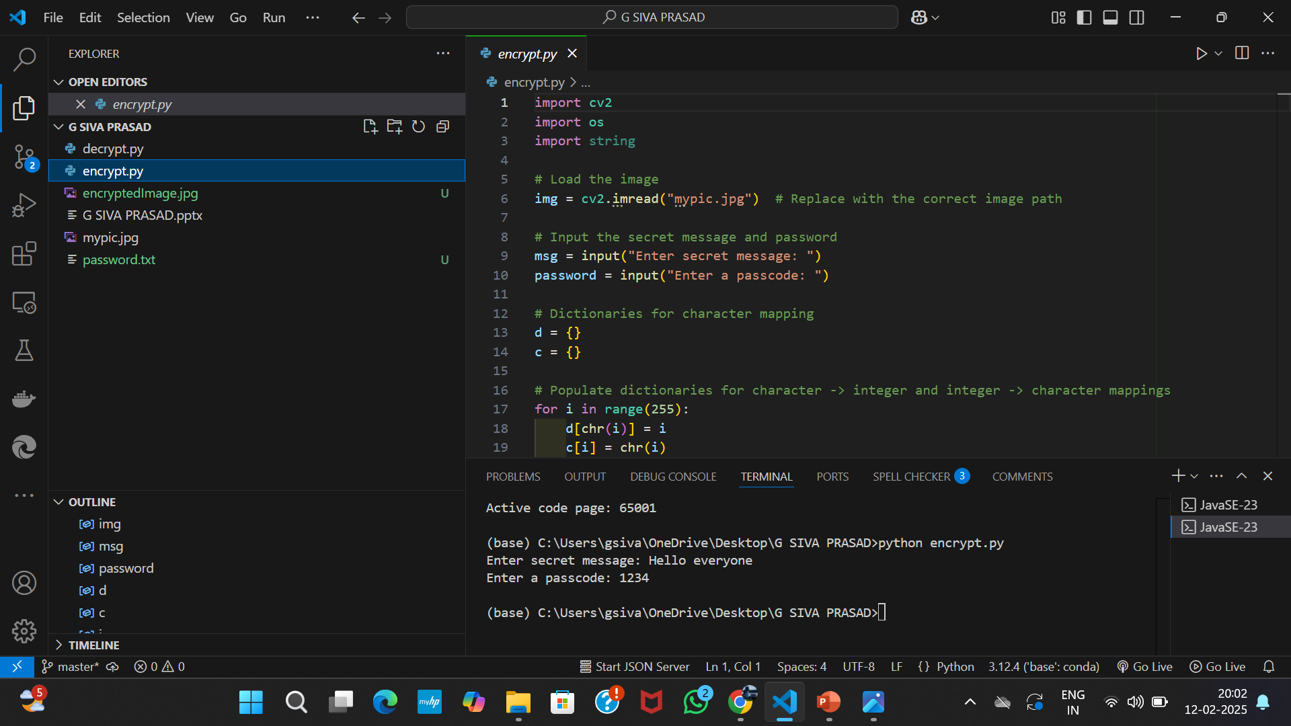
Results
Screenshots of the outcome (min 3)

Slide 8
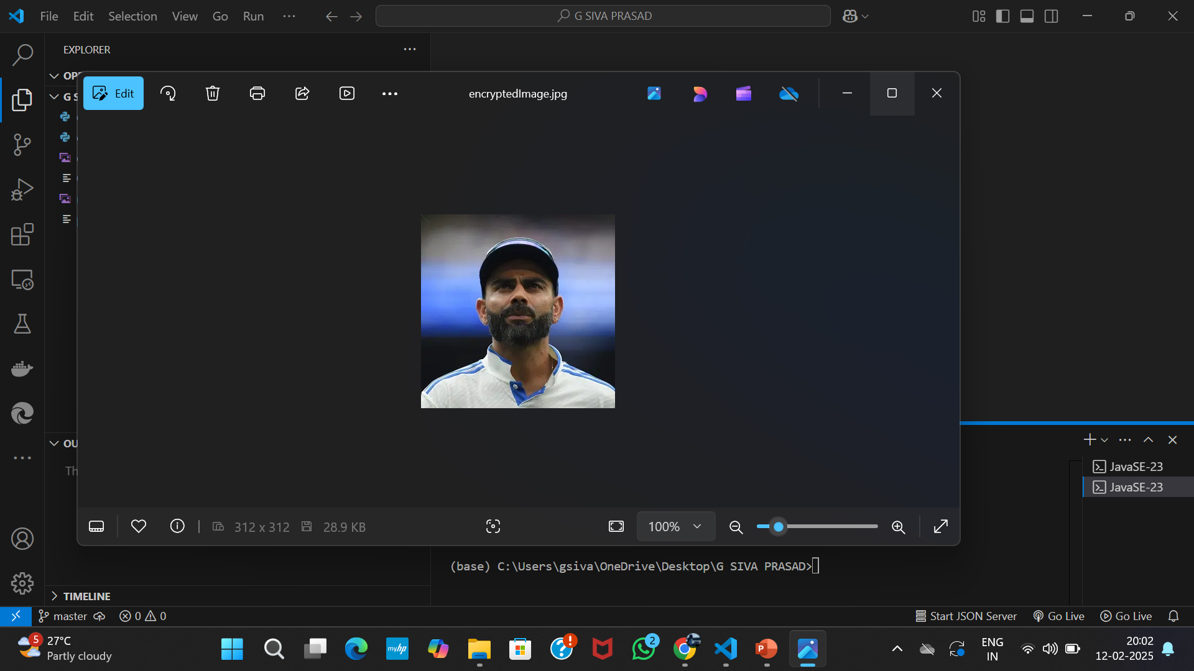


Slide 9
Conclusion
The "Secure Data Hiding in Images Using Steganography" project effectively demonstrates how data can be hidden within images to ensure confidentiality and privacy. By utilizing Least Significant Bit (LSB) steganography, the project embeds secret messages within image pixels, ensuring that the message remains invisible to the human eye while preserving the image’s quality. The addition of password protection enhances security, ensuring that only authorized users can decrypt and access the hidden data. This project showcases the powerful combination of image processing and cryptography, offering real-world applications such as secure communication, digital watermarking, and covert data transmission.

Slide 10
GitHub Link
https://github.com/G-SIVA1/Steganography-Project.git

Slide 11
Future scope(optional)
Multiple Data Embedding: Future versions could allow embedding multiple types of data (e.g., text, images, files) simultaneously into an image, increasing the versatility of the system.
Advanced Encryption Techniques: Integration of advanced encryption algorithms (like AES or RSA) for further securing the hidden data before embedding it, ensuring higher levels of security.
Detection and Anti-Steganography: Implement features to detect hidden data within an image and defend against steganalysis techniques, making the system resistant to detection by unauthorized parties.

Slide 12
THANK YOU

